Slide 1
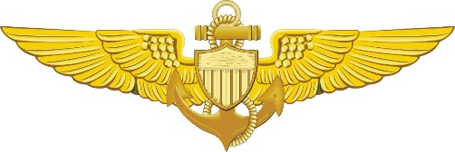
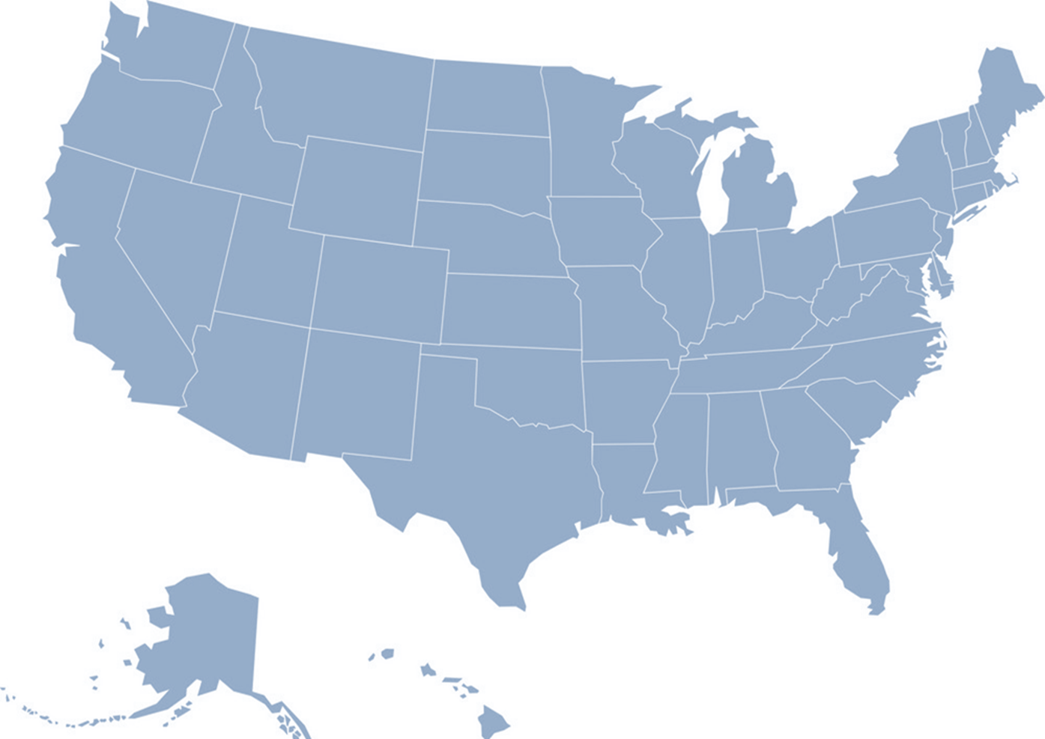
Kodiak – HC-130H/J, MH-65D, MH-60T
CSO: LCDR Zach Vojtech (23)
C-130: LCDR(s) Zachary Bowers (22)
MH-65D: LCDR(s) Carl Luxhoj (22)
MH-60T: LT Jonathan Ardan (22)
MH-60T: LCDR(s) Michelle Cosenza (23)
D17-DG-M-K-AirStaKodiak-Safety-Officers
U.S. Coast Guard Flight Safety Officers
Updated: June 2021
FSO Distro List: HQS-DG-LST-CGAS-FSO
Cape Cod – HC-144A, MH-60T
CSO: LT James Christy (22)
MH-60T: LT Jeff Mistrick (23)
HC-144B: LT Josh Castillo (23)
D01-SG-ASCC-AV-Safety
Port Angeles – MH-65D
FSO: LCDR Sam Hill (22)
D13-SG-M-AirStaSFOPortAngelesSafetyDeptHead
Traverse City – MH 60T
FSO: LT Dan Beshoar (23)
D09-DG-AIRSTATCity-Safety
Safety Program Mgmt, CG-1131
Chief: CDR Jeremy Denning
FW: CDR Ken Rockhold
TRNG: CDR Jim Cooley
RW: CDR Neal Corbin
DSF: LCDR Mike Feltovic
Assurance & Risk Reduction, CG-1132
Mr. Mark Bruno
HQS-DG-LST-CG-113-AVN
Atlantic City – MH-65D
CSO: LCDR Matt Hardgrove (22)
FSO: LCDR Andrew Cinque (22)
FSO: LT Anders Manley (22)
(NCR) LT Brian Peterson (22)
(NCR) LT Spencer Grinnell (23)
D05-DG-AIRSTAACITY-Safety
Sitka – MH-60T
FSO: LT Treston Taylor (22)
CMD-SMB-CG-AIRSTA-SITKA
D17-SG-M-AirStaSitka-Safety-Department
Columbia River – MH-60T
FSO: LCDR Jane Pena (23)
D13-SG-M-SecColRvrSafety
Detroit – MH-65D
CSO: LCDR Sam England (22)
MH-65: LT Brian Muldoon (23)
D09-DG-AIRSTADetroit-FSO
Aviation Safety Science
Post-Graduate Education Program
Auburn University
LCDR Andrew Kauffman (22)
University of North Dakota
LCDR Kevan Hanson (22)
LT Jim McCormack (23)
Columbia University
LCDR Dan Crowley (23)
Elizabeth City – HC-130J, MH-60T
CSO: LCDR Nicole Cannavo (23)
HC-130J: LT Zach Hunter (22)
MH-60T: LT Matthew Mayer (22)
C-130J (STAN): - LT Carl Schemel (23)
D05-DG-AIRSTAECITY-Safety
ATC Mobile
CSO: CDR(s) Dave McCarthy (24)
HC-144A (OPDEP): LCDR(s) Chris Smith (23)
D08-DG-ATCMOBILE-Safety
Safety Training and Standardization Div
Chief: LCDR Rob O’Donnell (23)
HC-144B: LCDR Gregory Quillen (22)
MH-65D: LT Logan Donahey (22)
MH-60T: LT Michael Klakring (23)
ASM: LCDR Linh Vinh (22)
D08-DG-ATCMOBILE-TRADEP-STSD
Washington – C37A/B
FSO: LCDR(s) Kimberly Wood (22)
HQS-DG-LST-Airstawashington-Safety
North Bend – MH-65E
FSO: LT Marguerite Champlin (22)
D13-DG-SectorNorthBendSafety
Savannah – MH-65D
CSO: LCDR Sam Ingham (23)
FSO: LT Adam Sherer (22)
D07-DG-ASSAV-SAFETY
Humboldt Bay – MH-65D
FSO: LT Ryan O’Neill (22)
D11-DG-M-SectorHumboldtBay-Safety
APO – C 27J
FSO: LT Andre Jones-Butler (23)
D05-DG-APO-Safety
Barbers Point – HC-130H/J, MH-65E
CSO: LCDR Damon Thornton (22)
MH-65D: LT Sarah Anderson (23)
HC-130J: LT John Stockton (23)
D14-DG-BP-FlightSafety-All
Sacramento – C-27J
Dept Head: LT Carter Schlank (22)
Asst. FSO: LT Terrell Jackson (23)
(STAN) LT Marshall Smith (22)
D11-DG-M-AirStaSacto-Safety
ALC – HC-130H/J, MH-65D/E, MH-60T / HC-144 / HC-27
CSO: LCDR Mark Dukti (24)
Mr. Gary Siatkowski
Mr. Kevin Duryea
D05-DG-ALC-SEHO
HITRON – MH-65D
Safety DH: LCDR John Magin (22)
FSO: LCDR Ian Campbell (22)
FSO: LT Brian Acuna (23)
FSO: LT Rachel Rychtanek (23)
FSO: LT Adam Guarno (23)
D07-DG-HITRON-SAFETY-DEPARTMENT
New Orleans – MH -65D
CSO: LT Alex Johns (23)
FSO: LT Zach Mauss (23)
D08-DG-AIRSTANewOrleans-Safety
Point Mugu FOB – MH-65D
FSO: LCDR Chris Artac (23)
D11-DG-M-AirStaSF-Safety
San Francisco – MH-65D
CSO: LCDR David Stern (23)
FSO: LCDR William Allen (23)
D11-DG-M-AirStaSF-Safety
Houston – MH-65E
FSO: LT Adam Scholl (23)
D08-DG-ASHouston-SafetyBoard
Clearwater – MH-60T, HC-130H
CSO: LCDR Eric Casida (22)
MH-60T: LT Travis Rhea (23)
MH-60T: LT Weston Dodson (23)
HC-130H: LT Ed Abma (23)
HC-130H (STAN):
LT Michael Carman (23)
D07-DG-ASCLEARWATER-SAFETY
Miami – MH-65D, HC-144A,
CSO: LCDR Kevin St.Cin (22)
MH-65D: LT Zach Gross (23)
HC-144B: LT Ronnie Russell (22)
D07-DG-ASMIAMI-SAFETY
Corpus Christi – MH-65D, HC-144B
CSO: LT Dan Gillis(22)
MH-65D: LT Leslie Marchalonis (23)
HC-144B: LT Bill Dise (23)
D08-DG-SecCorpusChristi-SAFETY-AVIATION
San Diego – MH-60T
FSO: LCDR Jack Shadwick (23)
D11-DG-M-SectorSD-Safety
Borinquen – MH-65D
FSO: LCDR John Reid (22)
D07-DG-ASBQN-Safety
Fly Competent, Resilient, and Effective (“Safe”)

